Slide 1
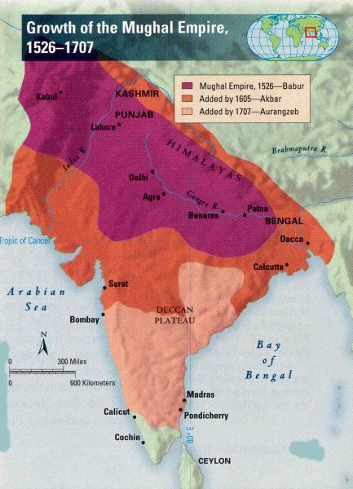
The Mughal Empire (1526 – 1707)
Pakistan Studies

Slide 2
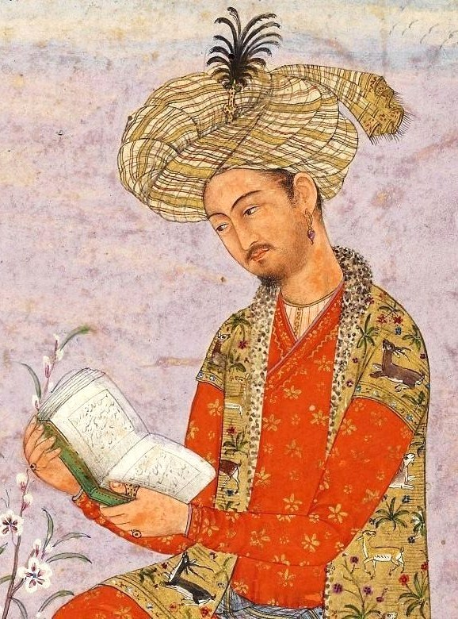
Zaheer ud din Muhammad Babar
Born 1483 in Farghana (modern day Uzbekistan)
From the Family of Taimur and Changez Khan
Father’s Name Umer Shaikh Mirza
Became king in 1494 at age of 11 after Mirza’s Death

Slide 3
Early life of Babur
First rebellion by Shabani khan in Samarkand (South-West of Farghana) 1495
Samarqand Conquered
Second rebellion by Shabani khan at Farghana
Farghana lost Also lost Samarqand in 1500 AD
King Without Territory

Slide 4
Time of Exile in Persia
1501 to 1504 in the court of Shah of Persia
Got early education
Strengthened military and war tactics

Slide 5
Babur as Ruler of Kabul
Attacked Samarqand and bukhara 1513 AD
Farghana defeated by Shabani khan’s forces
Moved towards India
Launched 4 attacks on India from 1519 – 1526 AD

Slide 6
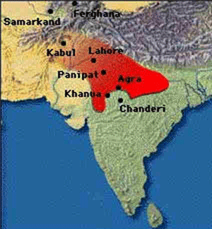
Formation of Mughal Empire
Kabul 1504
Lahore 1522 (Daulat Lodhi)
Panipat 1526 (Ibrahim Lodhi)
Khanwah 1527 (Rana Sanga)
Chagra (Agra) 1529 (Mehmud Lodhi

Slide 7
First battle of Panipat 1526
Forces of Ibrahim Lodhi and Rana Sanga
Babar won because of Tactics and use of artillery
Leadership of Babar was an important factor
Following battles were also won because of his cleverness, leadership and art of war

Slide 8
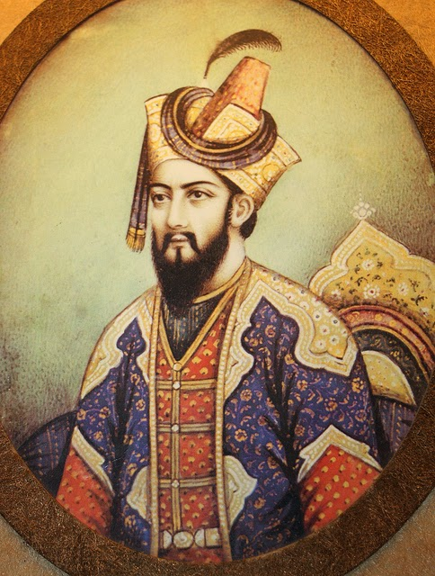
Causes of Babar’s Victories in India
His defeats in central Asia brought him to Sub-continent
Weak rulers of Sub-continent
War Strategies of Babar

Slide 9
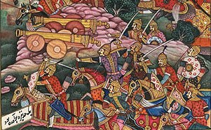
Babur as Emperor
Generous towards people
Away from Religious affairs
Never demolished any worship place

Slide 10
Mughal Empire
Babar did not consolidate empire
Empire became bankrupt
Rebellions started soon after Babar died

Slide 11
Effects of Babur’s Invasion
Laid foundation of Mughal Empire
Future kings of Mughal Empire will follow Persian tradition in court
Diplomacy along coercion became policy of state

Slide 12
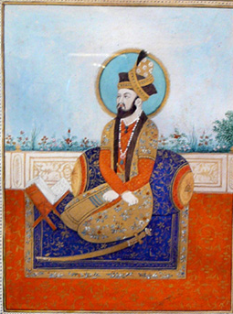
Humayun 1530 – 1540 AD & 1555 – 1556 AD
Became King after death of Babur in 1530 AD
Empire was not consolidated
He also tumbled through his life

Slide 13
Difficulties of Humayn
Empire was not consolidated
Empire started to bankrupt
No effective administration
Bengal was still not conquered
Threat of Sur started to engulf

Slide 14
Difficulties of Humayn
Humayun did not cared much about people’s welfare
He left most of the expeditions incomplete
He had temperament issue in his nature
Most importantly he relied so much on his brothers who betrayed him when he needed them
Hindal and Kamran did not secure Humayun of Suri Threat

Slide 15
Battle of Qanuj 1540 AD
Humayun did not lead troops well
Rainfall further weakened strategic position of Mughal Army
Sher shah Suri won the battle and Delhi fell into hands of Sur’s of Bengal for next 15 years

Slide 16
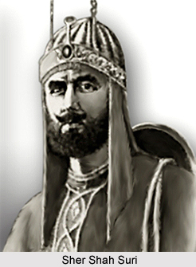
Sher Shah Suri
Administrative Reforms
47 Sarkar (divisions)
Pagna (Tehsil)
Village
Revenue Reforms
Land distribution
Classification of land
Rate of Revenue
Methods of Revenue Collection
Methods of Revenue Assessment
Taxes other than Revenue
Military reforms
Justice
Police and Spying system
Public Welfare works
Monitory Reforms

Slide 17
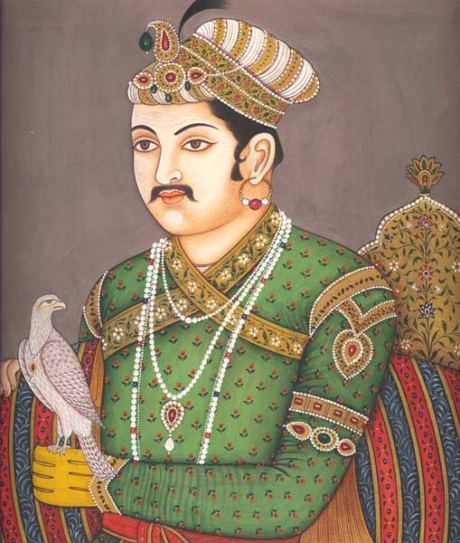
Jalal ud din Akbar 1556 – 1605
After sudden death of Humayun Akbar became king
Bairam khan his loyal army commander crowned him king
Young at age of 13 he had to control and hold huge responsibility
During his early time to kingdom he started to reduce any possible rebellions
First he met Himu in the second battle of Panipat
Then he moved towards possible sur claimants
At time of Akbar Sindh, Bengal, Gujrat, Kashmir, Malwa, Deccan, Orissa and Balochistan were enjoying independent status

Slide 18
Akbar’s Rajput Policy
Diplomatic relations with Rajputs
Went in matrimonial alliances with Rajputs
Granted High Positions
Adopted Sulh Kul policy
Suppressed rebelling Rajputs with the help of allied Rajputs
8 out of 12 Diwan’s were given to Rajputs

Slide 19
Benefits of Rajput Policy
Rajputs proved to be loyal to king
Rajputana was conquered with very few battles
Western borders were safe from any possible aggression of Afghans
Important sea routes of trade were connected with Dehli and Agra via Rajputana
Nobels/Diwans did not attempt to invoke any revolt against king because of Rajputs in Nobility
Sympathy of Hindus was gained
Rajput army power helped to further expand the empire

Slide 20
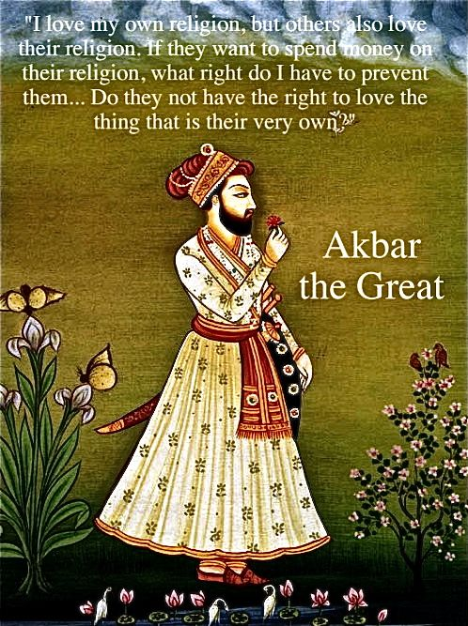
Social Reforms of Akbar
Encouraged Art and Literature
Reduced Taxes
Banned practice of Sati
Banned Child Marriage
Abolished enslavement of war prisoners
Built translation houses

Slide 21
Religious Policy of Akbar
He was follower of Wahdatul wajud (Sufi)
Initially adopted Sulh-e-Kul (peace for All)
Built Ibadatkhana for religious and philosophical discussions
Scholars and clerks of all religions held discussions in Ibadatkhana
Later introduced Din-i-Ilahi (1582)
Ordered to bow before King (himself)
Allowed inter caste and inter religion marriages
Adopted more secular policy
He Married to Hindu wives Jodha Bai is one of the famous queens

Slide 22
Mansabdari System
No distinction between civil and military
Grades in Mansabdari
Fixation of Salary
No regular post or duty was required
Sub groups of Mansabdar
Appointment, dismissal and promotion criteria
Escheat system (Property confiscation in case of Mansabdar’s Death)

Slide 23
Merits of Mansabdari System
Helped maintaining huge army without central command
Sense of competition among different mansabdars so a healthy competitive environment encouraged efficiency
It was best substitute of Jagirdari system
King had contact to the people

